Slide 1


IBET GAME BASICS
Feb 15, 2024
Notes:
This presentation outlines the purpose, design, and progress of the GAME bioreactor

Slide 2
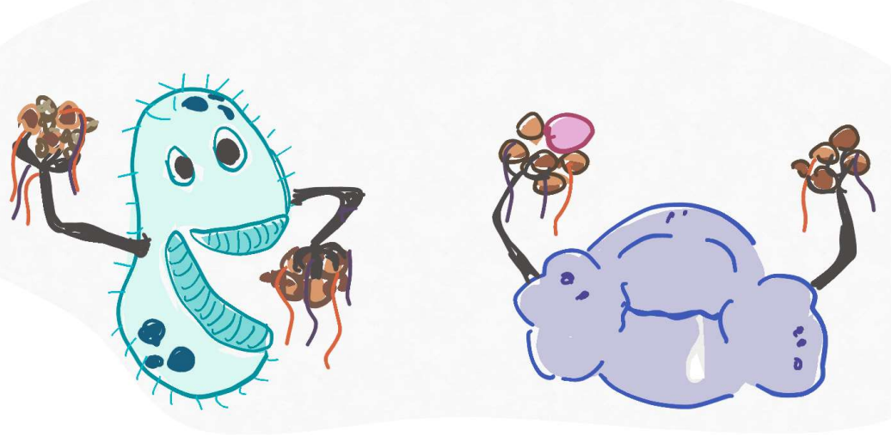
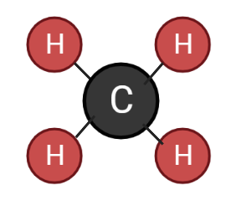
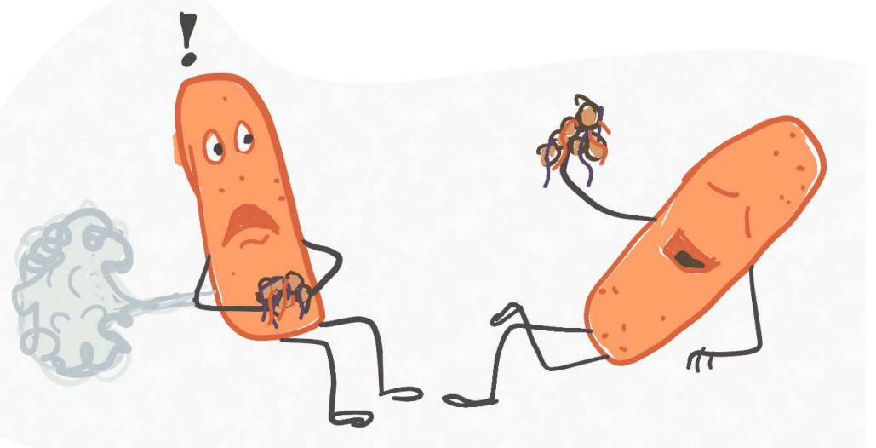
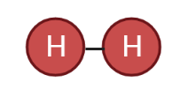
The GAME reactor selects for hydrogenotrophic methanogens to consume CO₂ and H₂
HYDROGENOTROPHIC METHANOGENS
HYDROGEN
EATING
METHANE
MAKERS
${CO}_{2}+{4H}_{2}→{2H}_{2}O+{CH}_{4}$

Slide 3
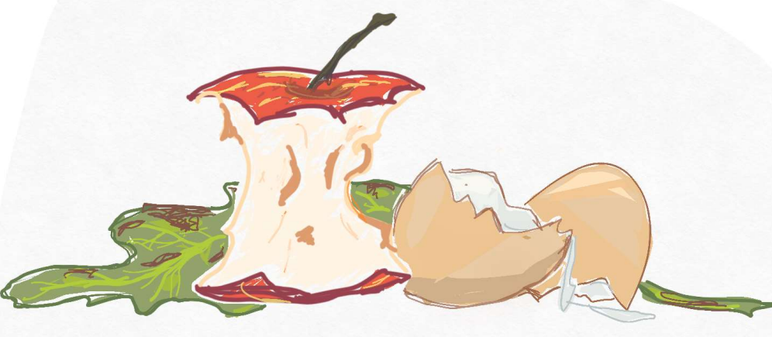
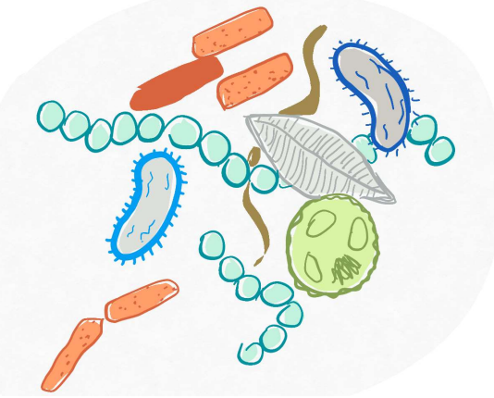
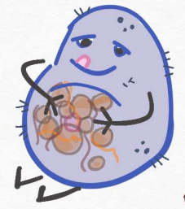
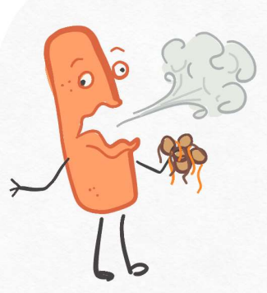
Methanogenesis is the fourth step in anaerobic digestion
Complex organic matter: proteins, fats, carbohydrates, cellulose
Step 1. Hydrolysis
Soluble organic molecules: sugars, amino acids, fatty acids
Step 2. Acidogenesis
Volatile fatty acids
Step 3. Acetogenesis
Acetic acid
${CO}_{2}+H_{2}$
Step 4. Methanogenesis
${CO}_{2}+{CH}_{4}$
Notes:
https://biovoima.com/en/biogas

Slide 4
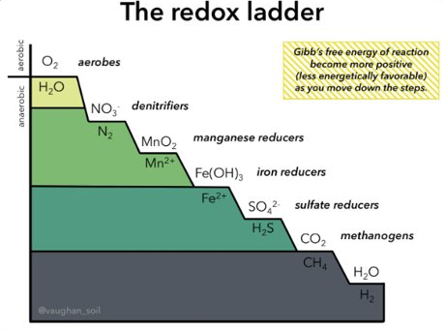
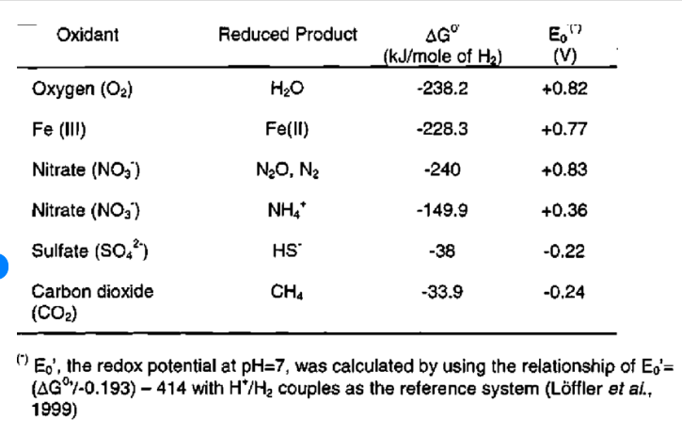
Electron acceptors (oxidants) other than CO2 must be removed from the system to select for hydrogenotrophic methanogens
Lower Gibbs free energy of reaction (ΔG˚) indicates more energetically favorable reaction
Only feeding reduced forms of sulfate, iron, manganese, etc.
Notes:
Sample mapping slide.
Reference:
Katrina Aspmo, Torunn Berg, and Grethe Wibetoe, “Atmospheric Mercury Depletion Events (AMDEs) in Polar Regions During Arctic Spring,” presentation (Oslo, Norway: University of Oslo, 16 June 2004).

Slide 5
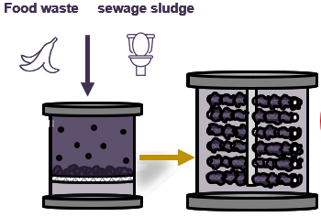

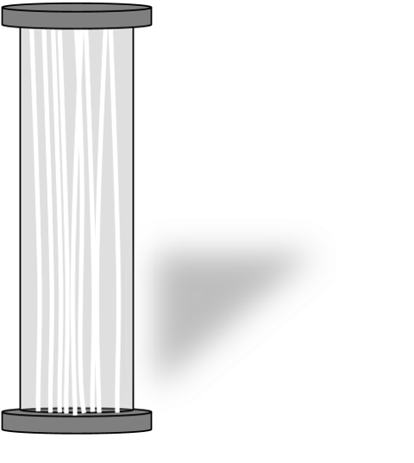
The GAME bioreactor converts carbon dioxide from upstream anaerobic processes to methane
98% CH₄
98% CH₄
BIOGAS
HCO₃⁻
75% CH₄
Water alkaline electrolysis cell
25% CO₂
GAME
Hydrogenotrophic biomethanation
Mixed community anaerobic digester
CO₂ gas dissolves in water
H₂

Slide 6
Limited solubility of H₂ gas leads to inefficiencies in CH₄ production
Solubility in Pure Water
Use molecular mass to convert to moles
CO_{2(g)} : 0.169 g/100 mL
H_{2(g)} : 0.00016 g/100 mL
0.0384 mol/L
0.000794 mol/L
But what does it mean?
≈48x
Molecules of CO_{2(g)}
Molecules of H_{2(g)}
Notes:
Talk about diffusion kinetics
The speed at which these molecules diffuse into water prevents efficient consuption

Slide 7
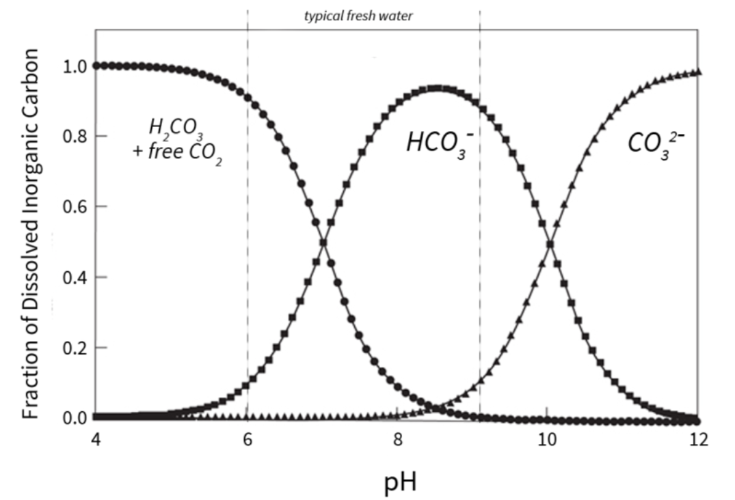
The relationship between pH and forms of dissolved CO₂ determines whether CO₂ escapes as gas
Image Source: importance of general chemistry relationships in water treatment mealy bowman

Slide 8

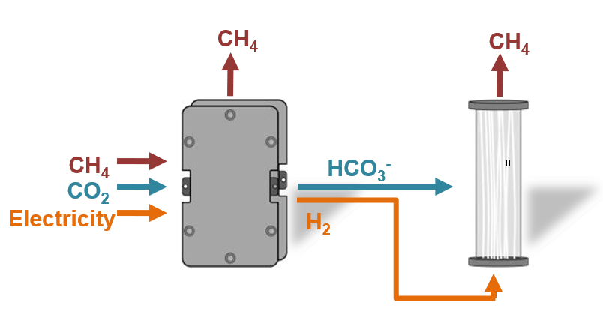
The combined ERCHD and GAME reactor eliminates competitive dissolution of H₂ and CO₂ gas
HCO₃⁻
H₂
H₂
H₂
HCO₃⁻
H₂
H₂
H₂
HCO₃⁻
BIOFILM FORMATION
Notes:
Only have to worry about dissolving hydrogen – co2 already present, available, and abundant
Talk about diffusion kinetics

